Slide 1
Online Exam Flowcharts
Ed John Paul D. Gallardo

Slide 2
Sign-Up Flowchart

Slide 3
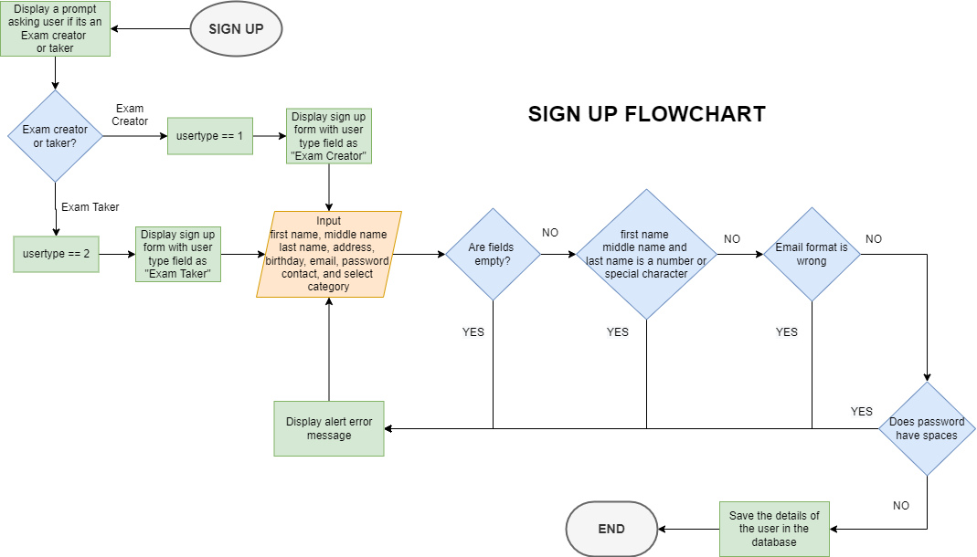

Slide 4
Login Flowchart

Slide 5
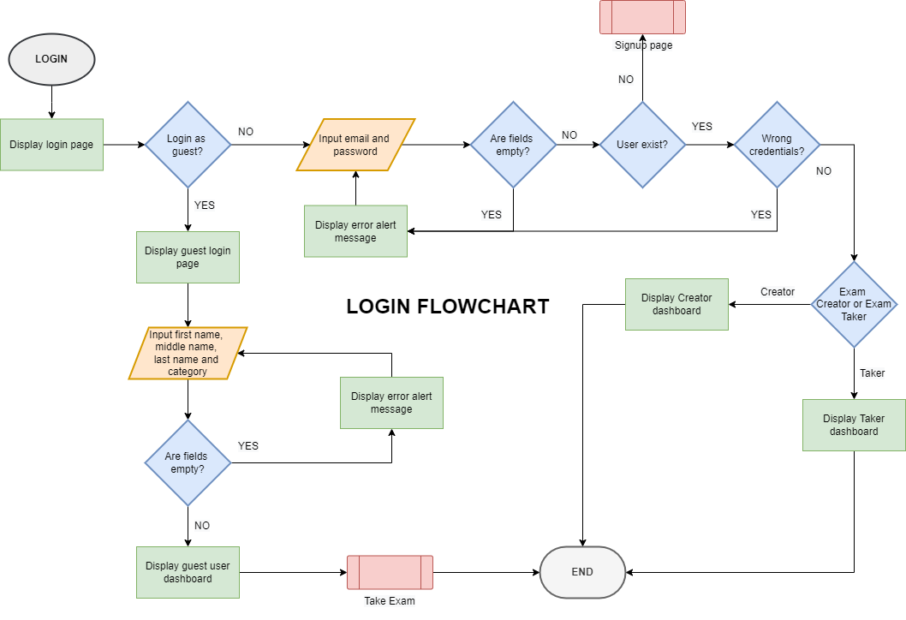

Slide 6
Exam Creator Side

Slide 7
Create Exam Flowchart

Slide 8
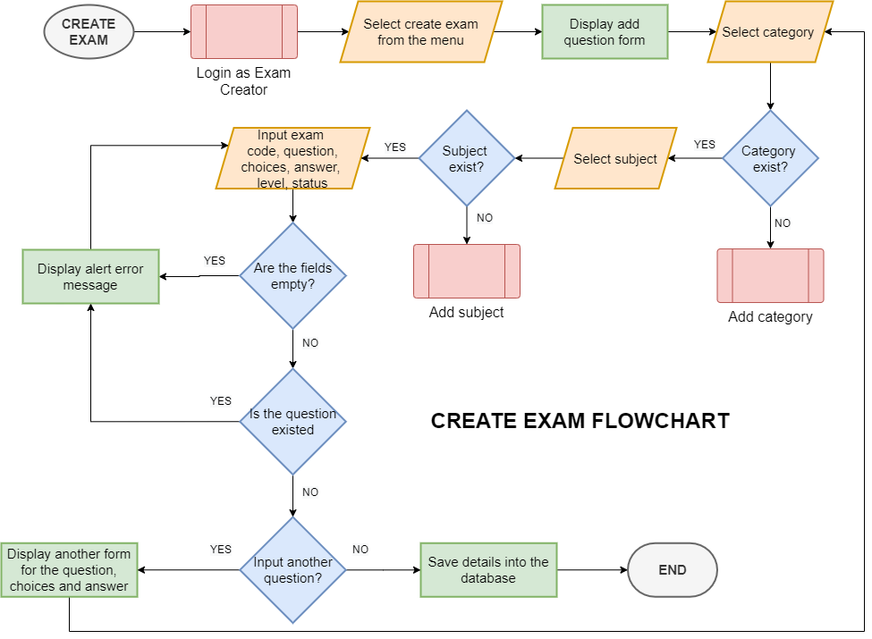

Slide 9
Add Questions Flowchart

Slide 10
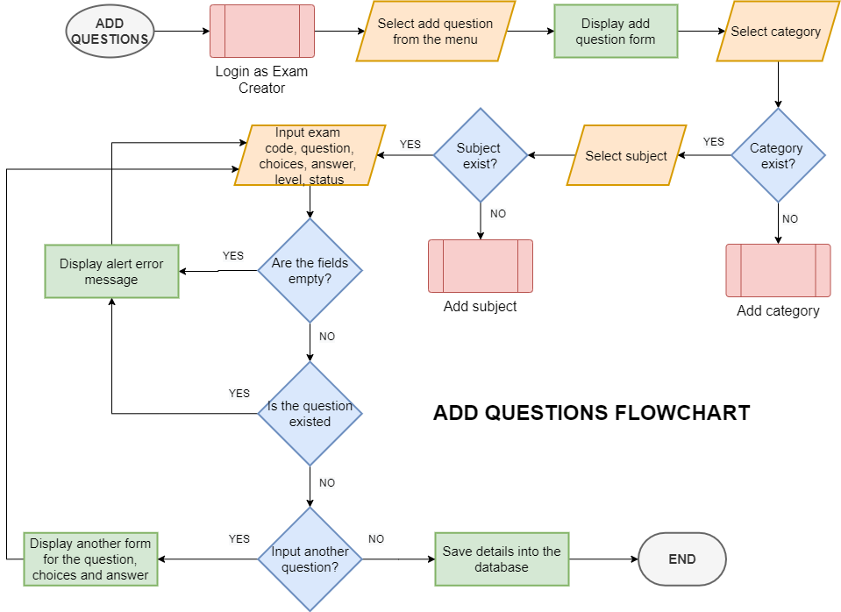

Slide 11
View Created Exams

Slide 12
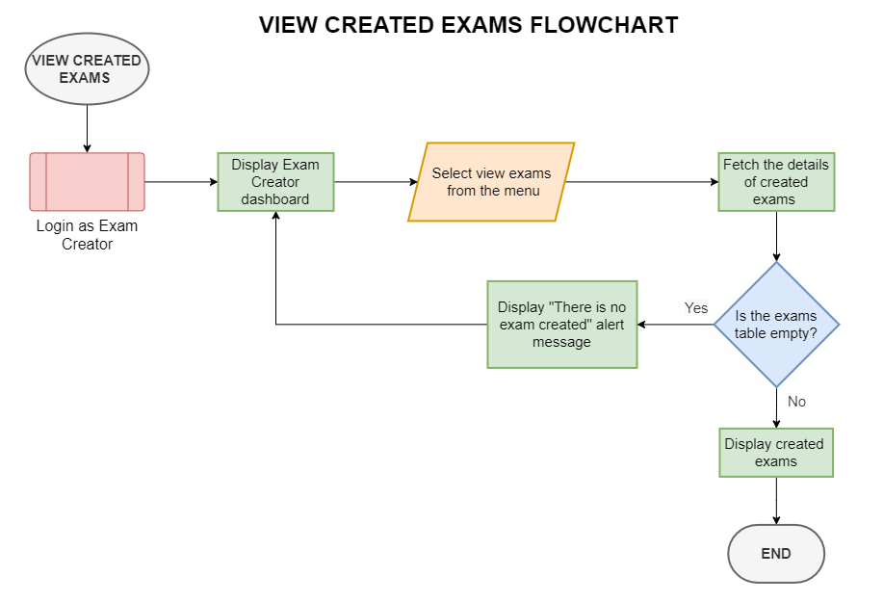

Slide 13
Edit Created Exams

Slide 14
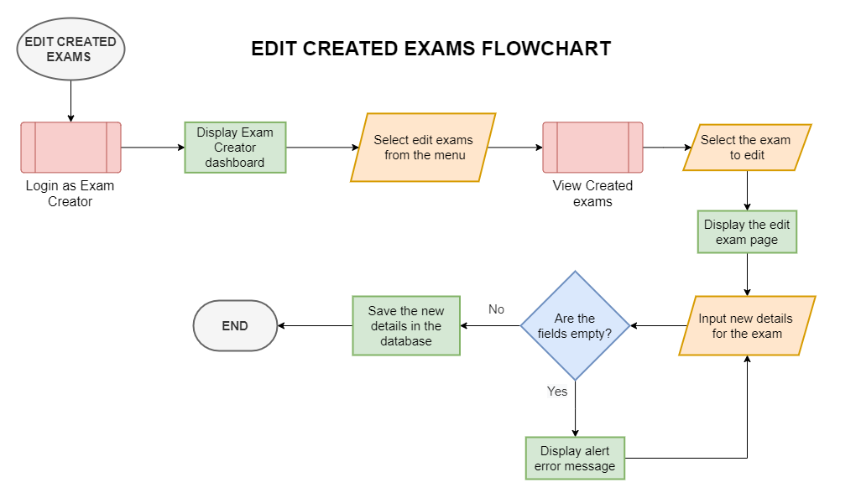

Slide 15
Delete Created Exams

Slide 16
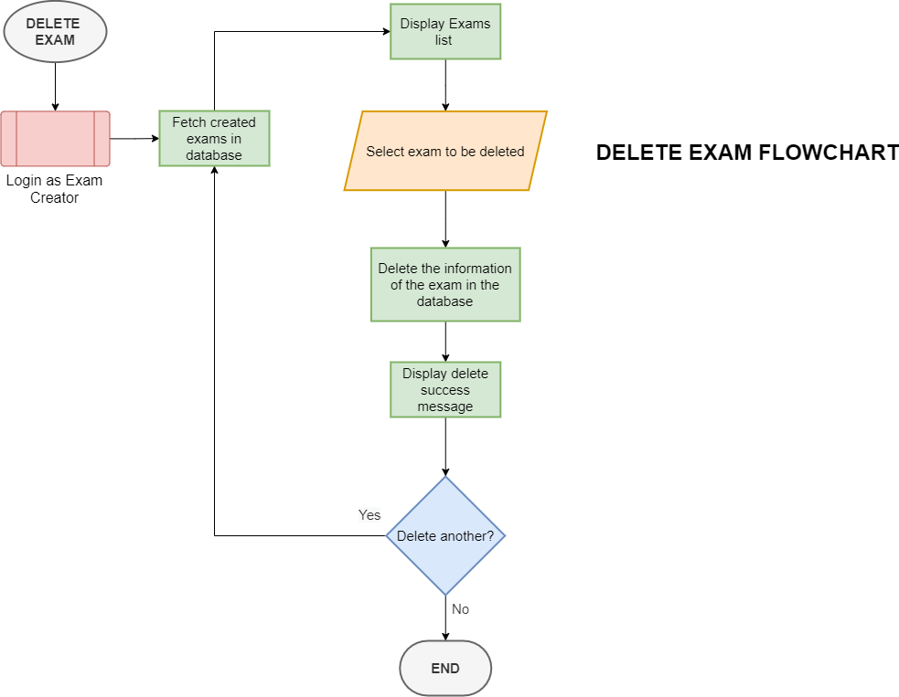

Slide 17
Add Category Flowchart

Slide 18
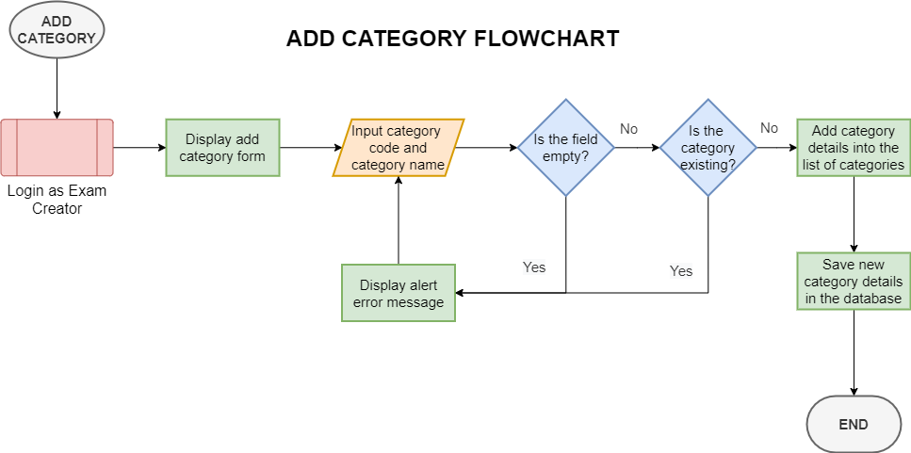

Slide 19
Edit Category Flowchart

Slide 20
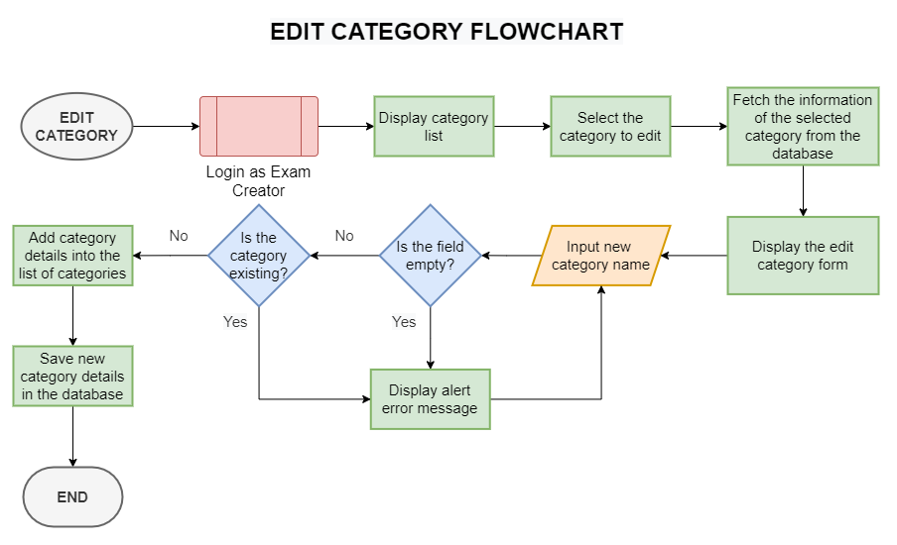

Slide 21
Delete Category Flowchart

Slide 22
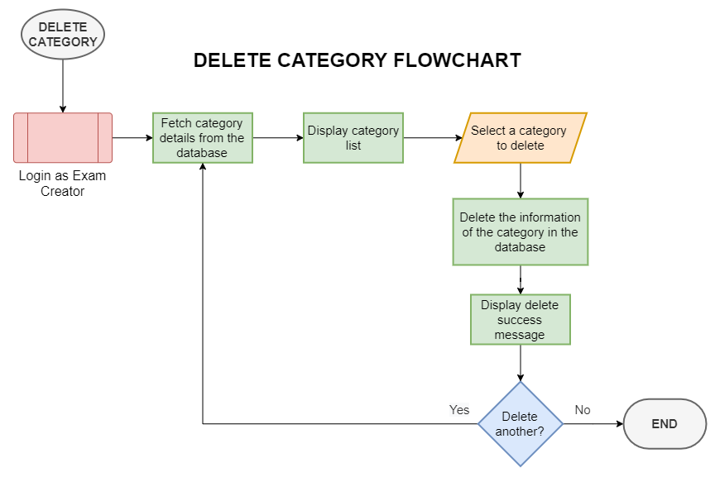

Slide 23
Add Subject Flowchart

Slide 24
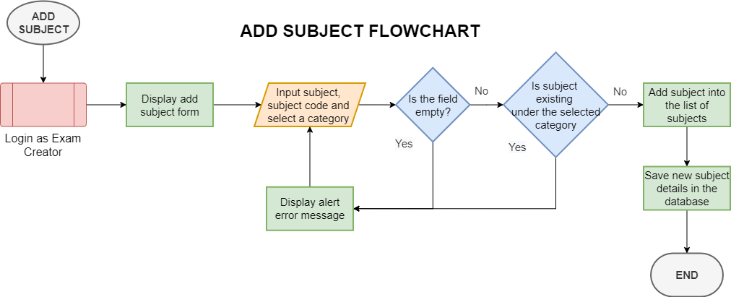

Slide 25
Edit Subject Flowchart

Slide 26
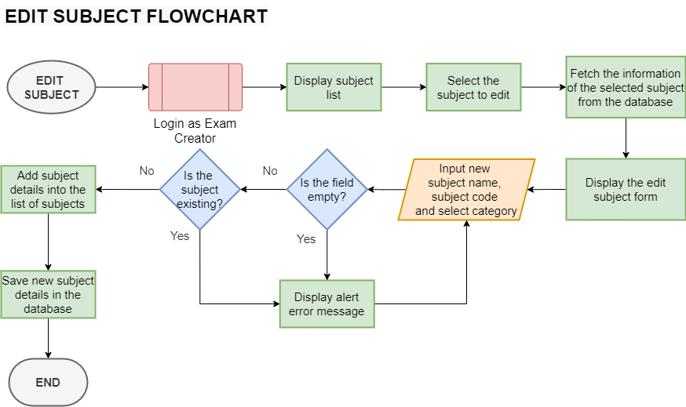

Slide 27
Delete Subject Flowchart

Slide 28
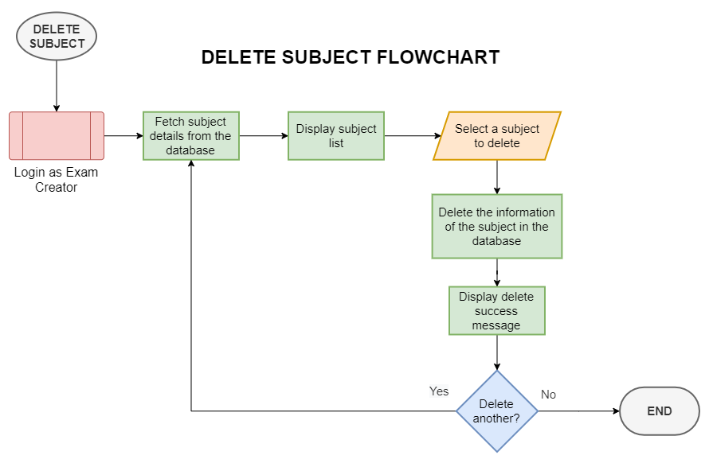

Slide 29
View Exam Taker’s Details Flowchart

Slide 30
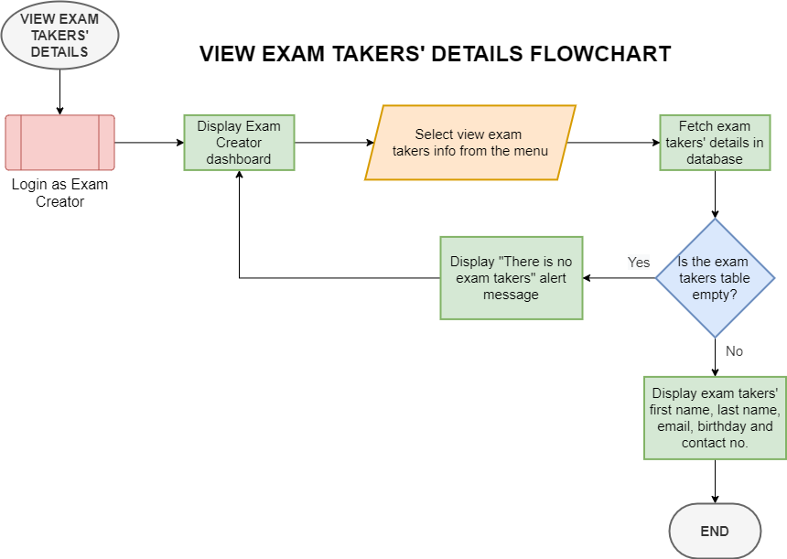

Slide 31
View of Summary of Scores

Slide 32
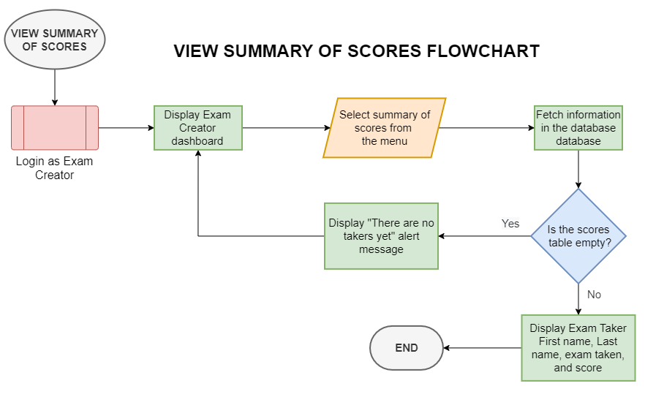

Slide 33
Update Exam Creator’s Info

Slide 34
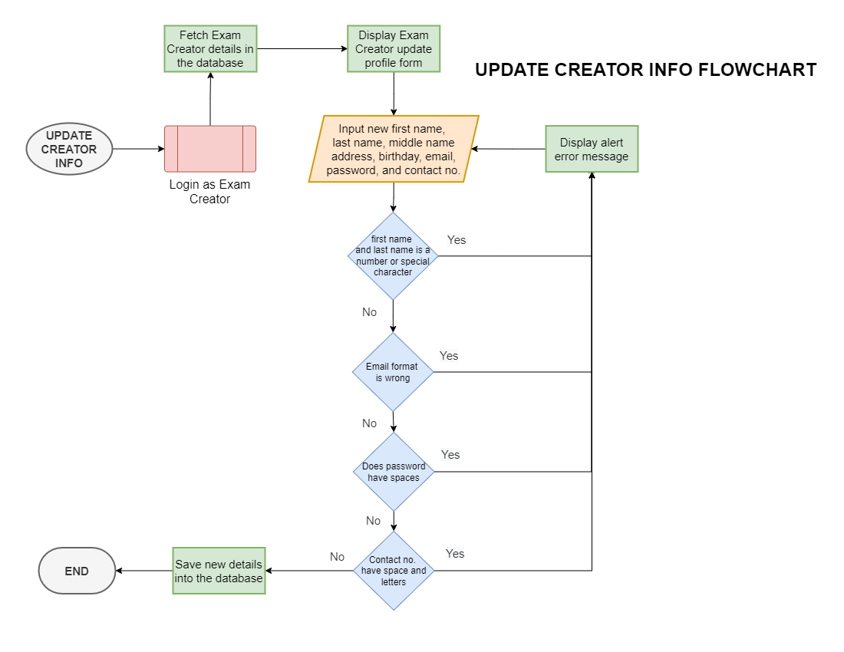

Slide 35
SET EXAM SETTINGS

Slide 36
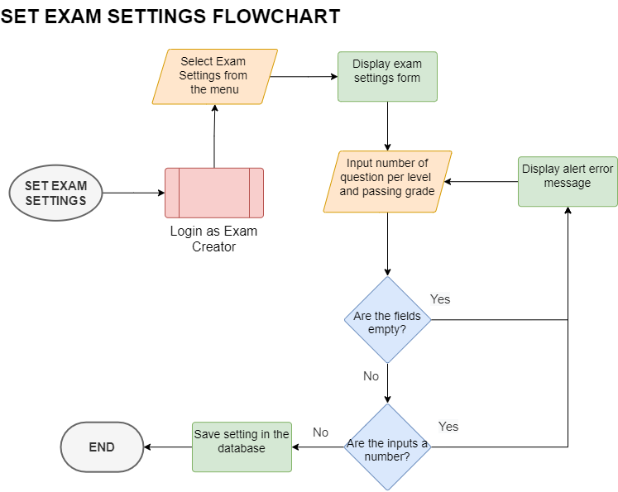

Slide 37
Exam Taker Side

Slide 38
Update Taker Info Flowchart

Slide 39


Slide 40
View Exams to Take Flowchart

Slide 41
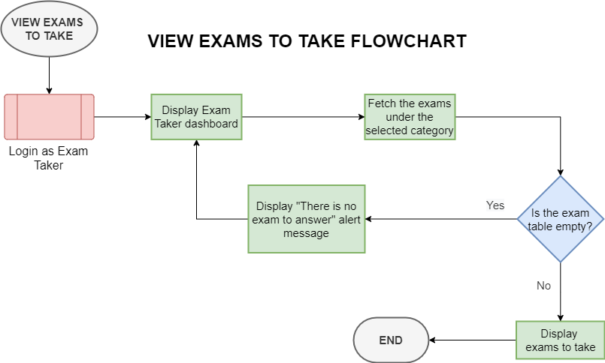

Slide 42
Take Exam Flowchart

Slide 43
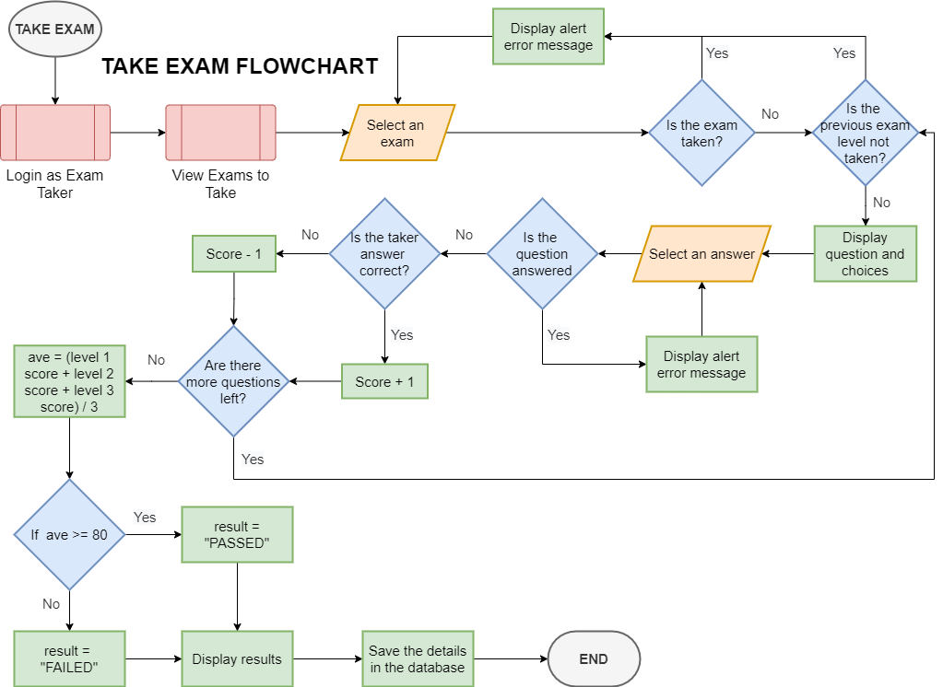

Slide 44
View Exam Score Flowchart

Slide 45
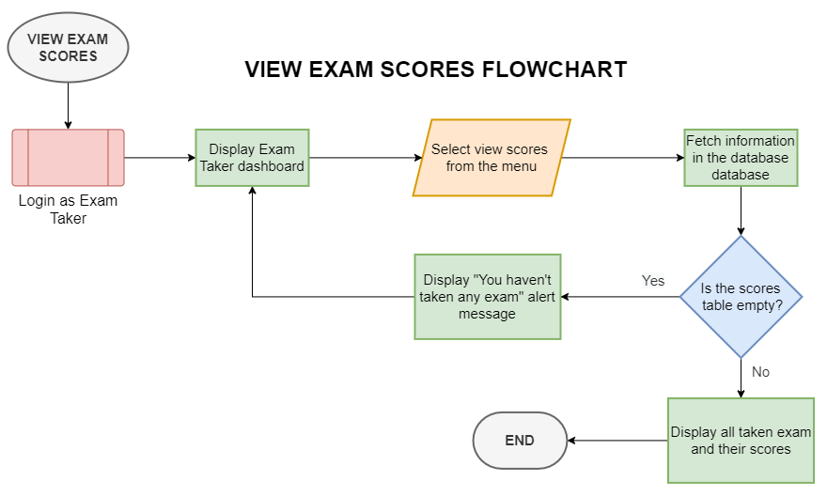

Slide 46
Page Designs

Slide 47
Sign-Up Page Design

Slide 48
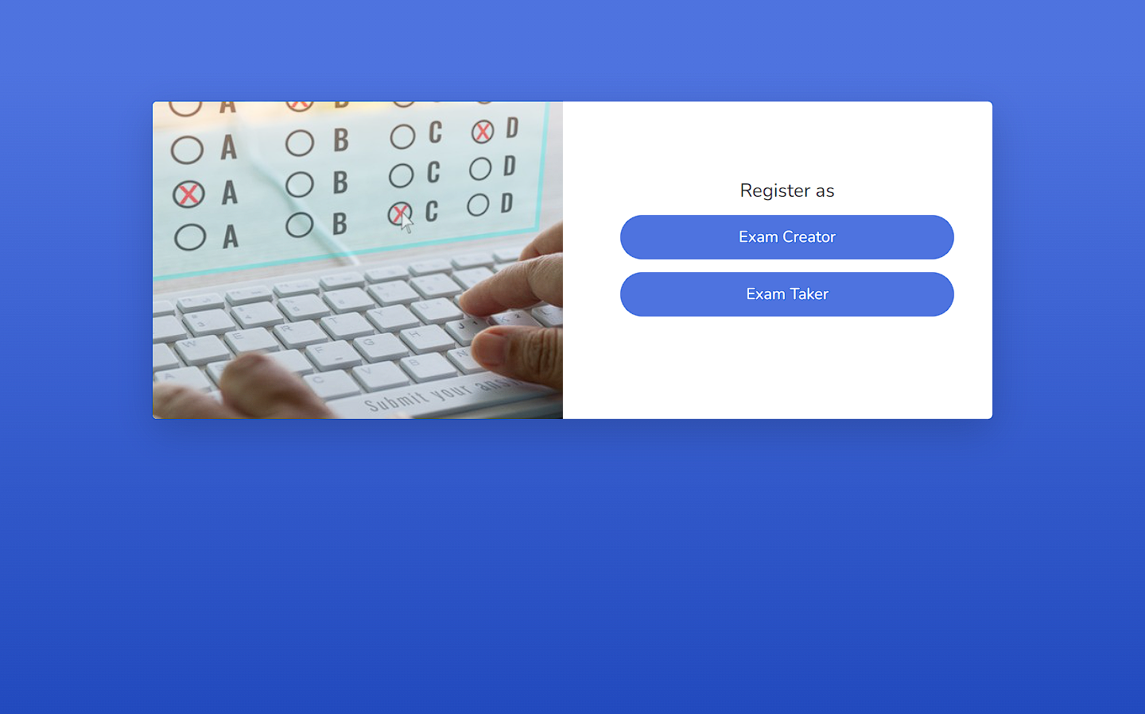

Slide 49
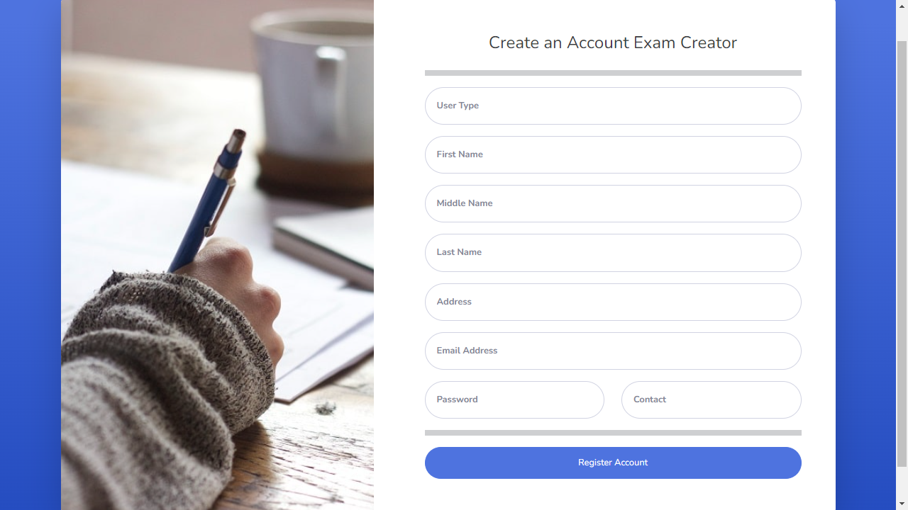

Slide 50
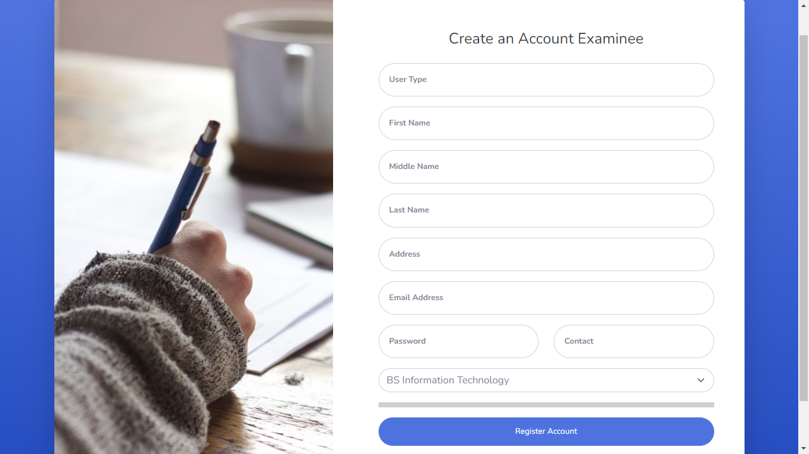

Slide 51
Login Page Design

Slide 52
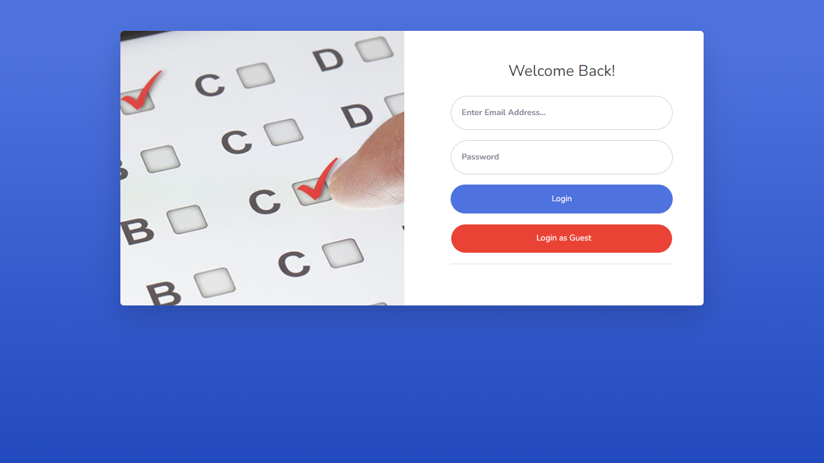

Slide 53


Slide 54
Exam Creator Dashboard

Slide 55
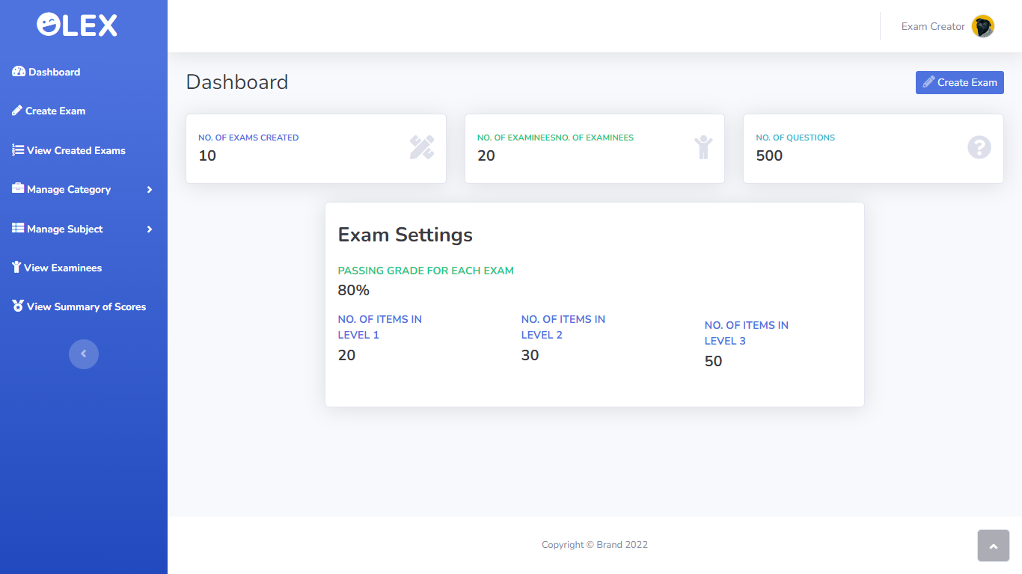

Slide 56
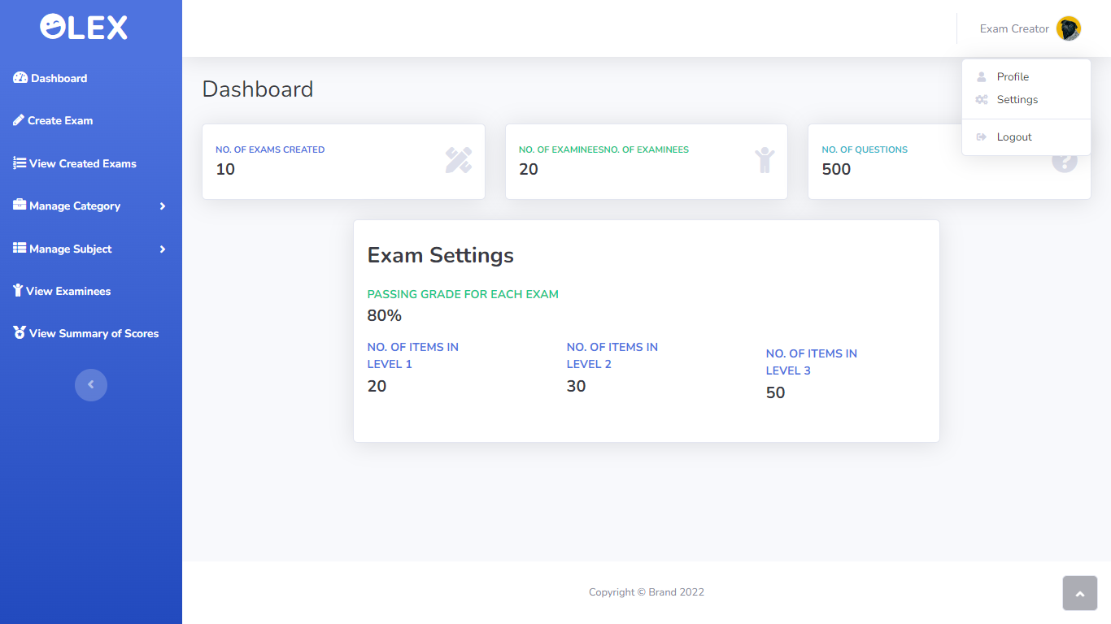

Slide 57
Create Exam Page

Slide 58
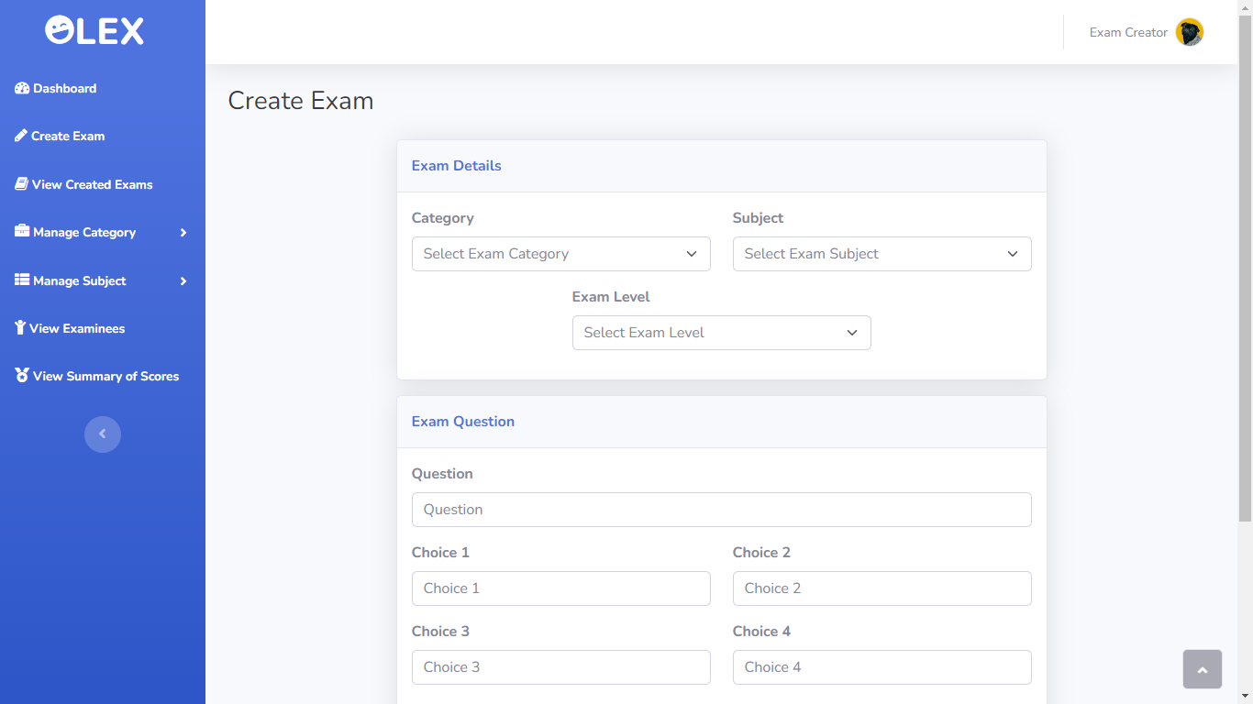

Slide 59
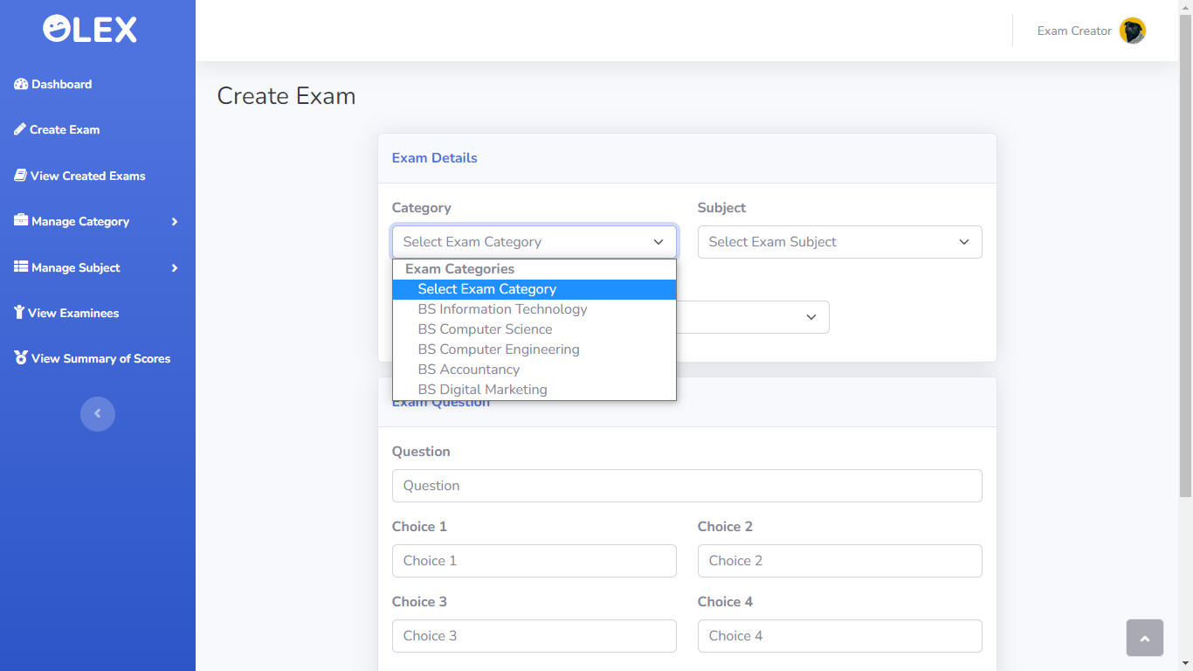

Slide 60
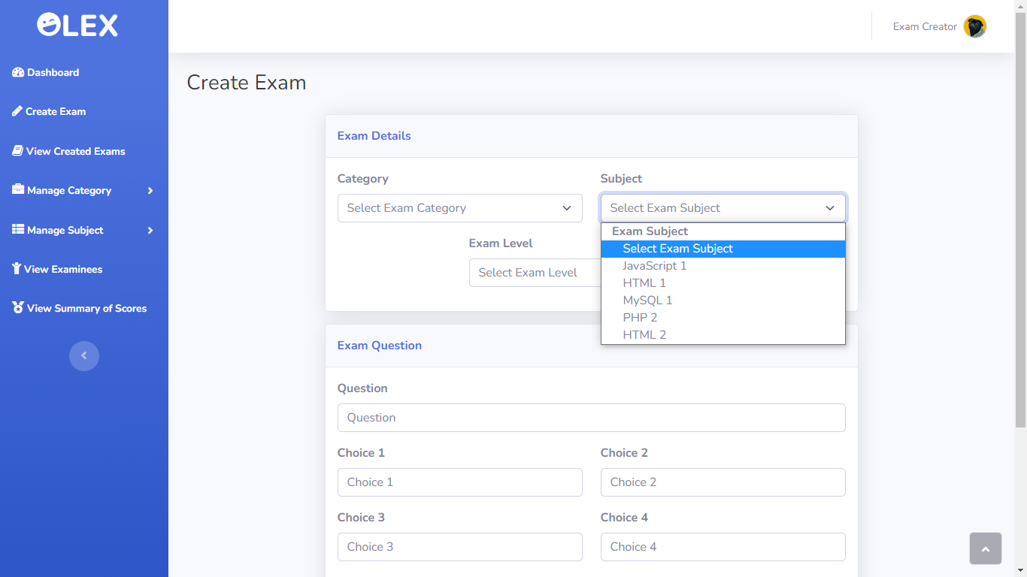

Slide 61
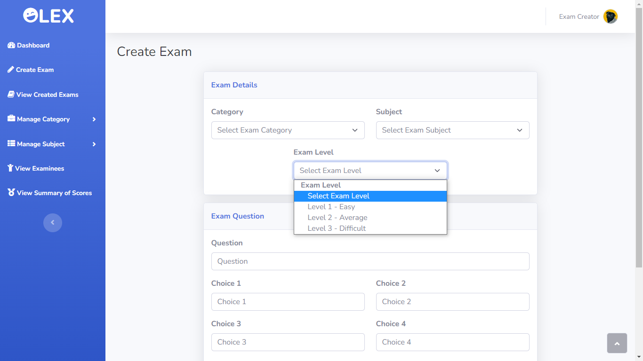

Slide 62
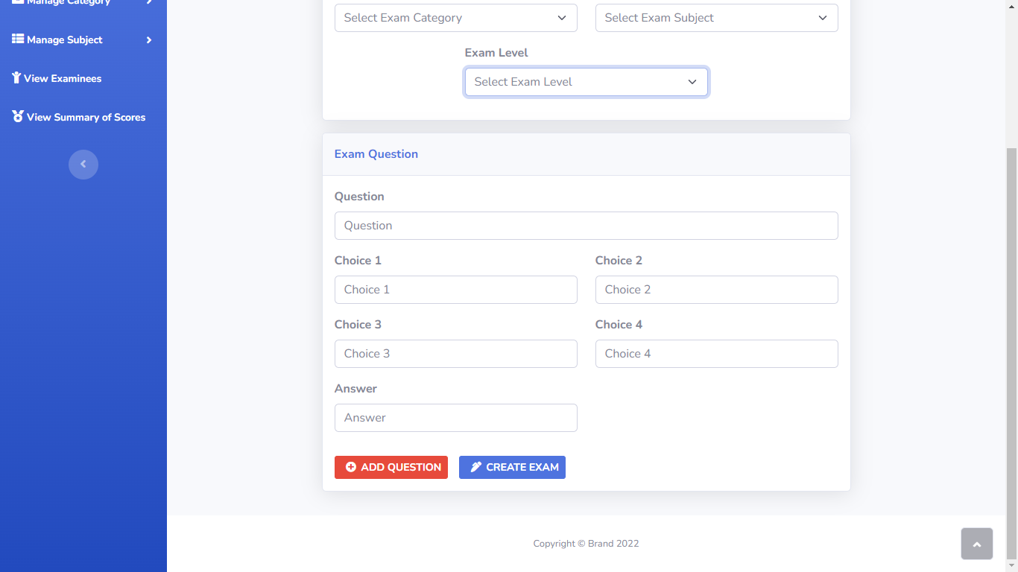

Slide 63
View Created Exams

Slide 64
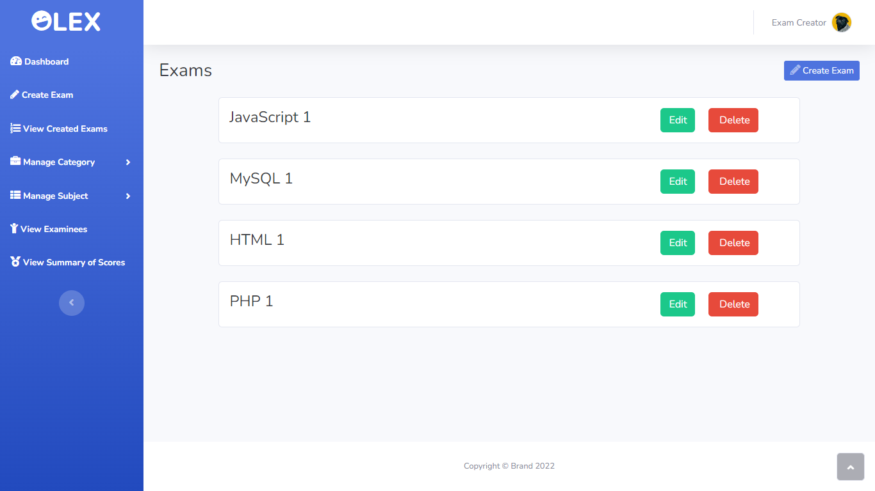

Slide 65
Edit Created Exam

Slide 66
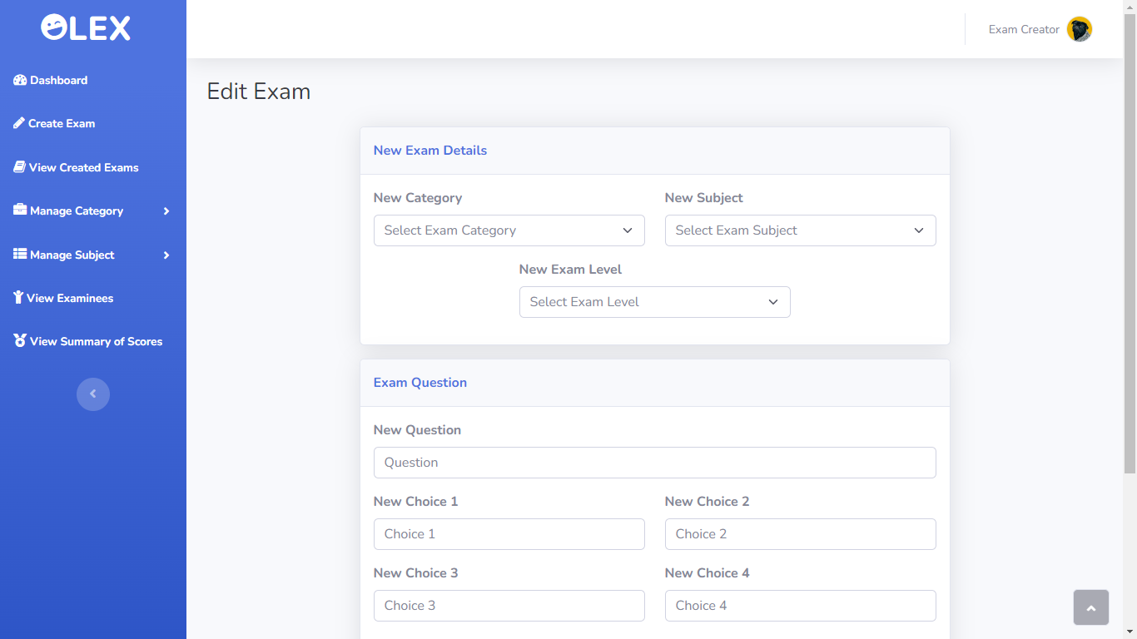

Slide 67
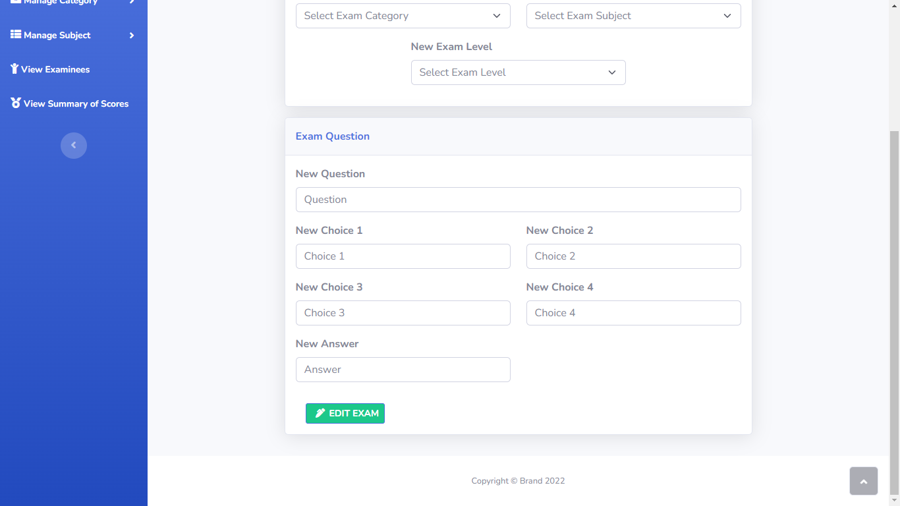

Slide 68
Add Category Page

Slide 69
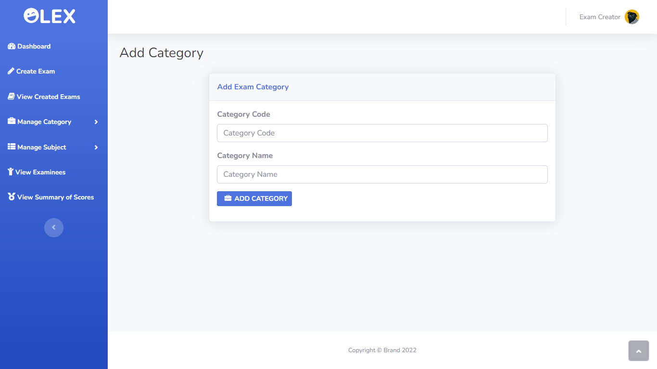

Slide 70
View Category Page Design

Slide 71
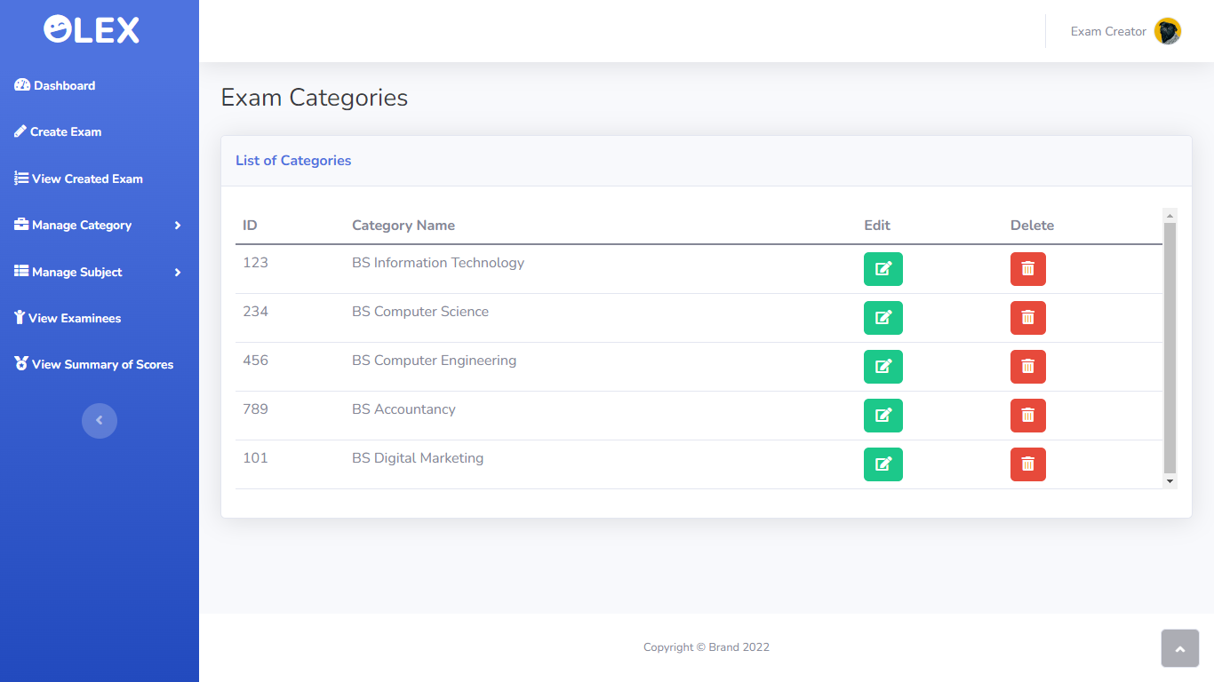

Slide 72
Edit Category Page

Slide 73
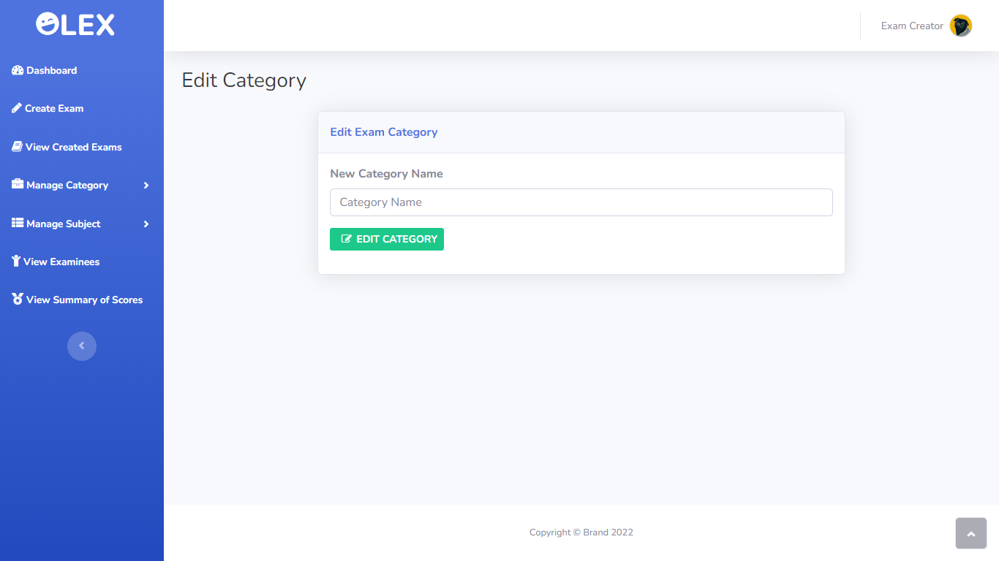

Slide 74
Add Subject Page Design

Slide 75
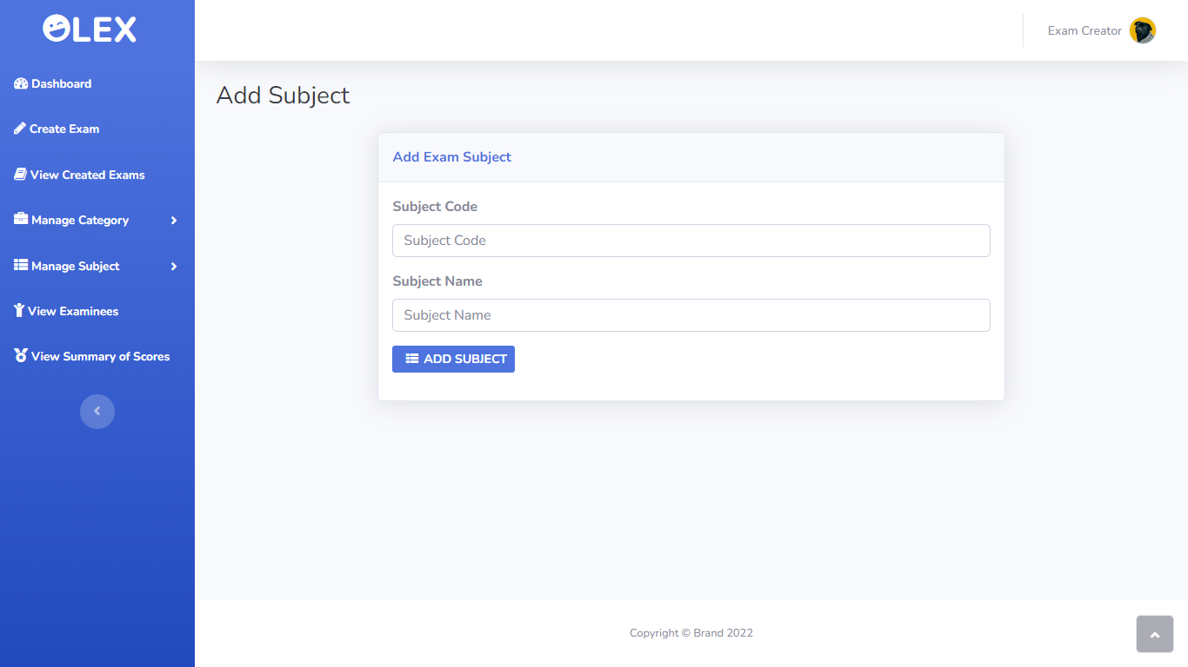

Slide 76
View Subject Page Design

Slide 77
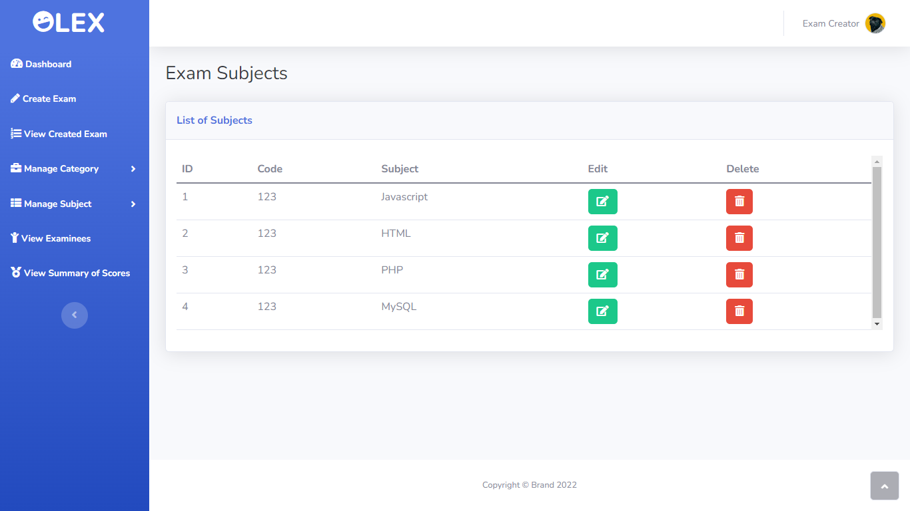

Slide 78
Edit Subject Page

Slide 79
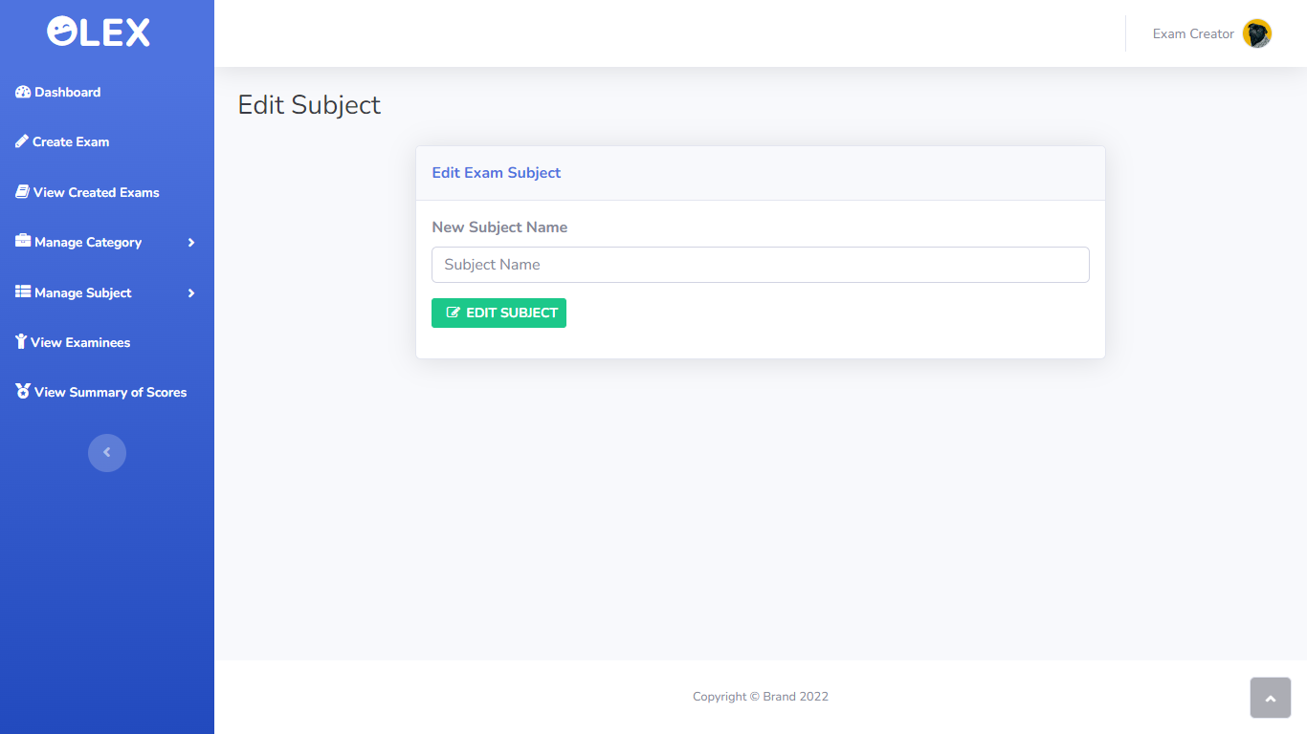

Slide 80
View Summary of Scores

Slide 81
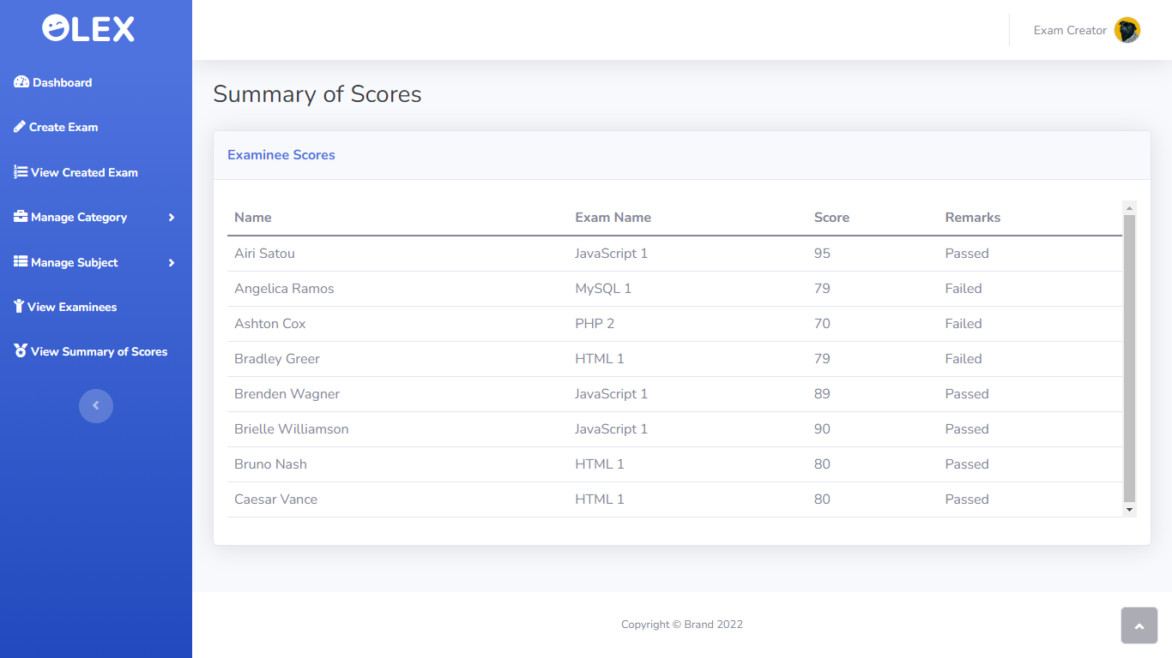

Slide 82
View Exam Takers Info

Slide 83
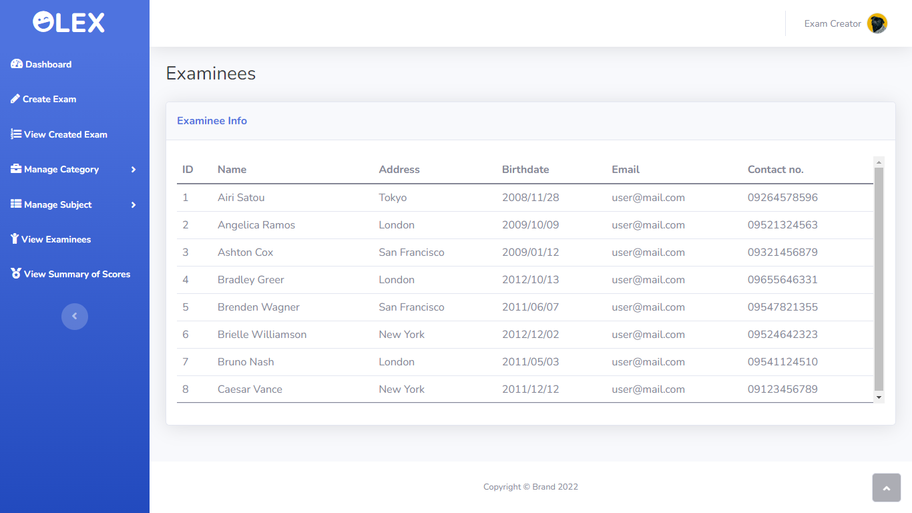

Slide 84
SET EXAM SETTINGS

Slide 85
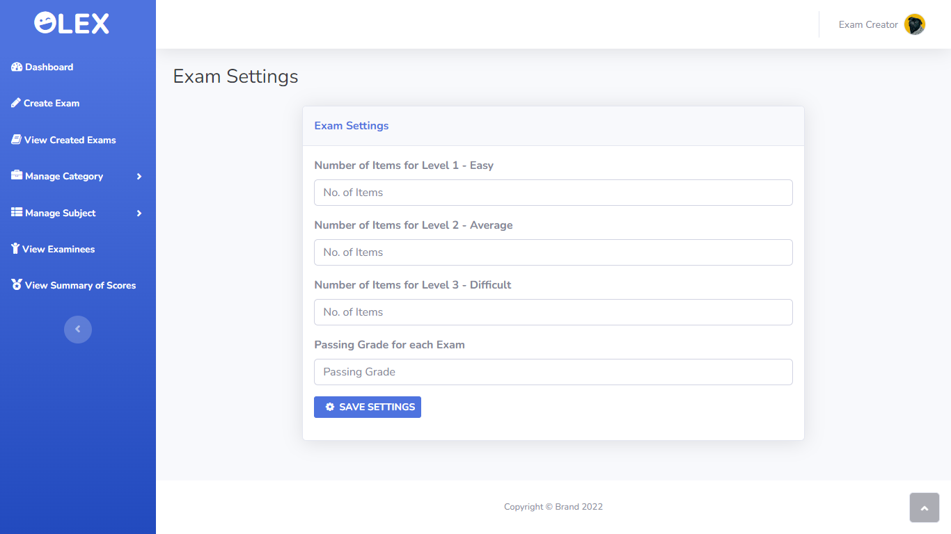

Slide 86
Exam Creator Update Profile Page Design

Slide 87
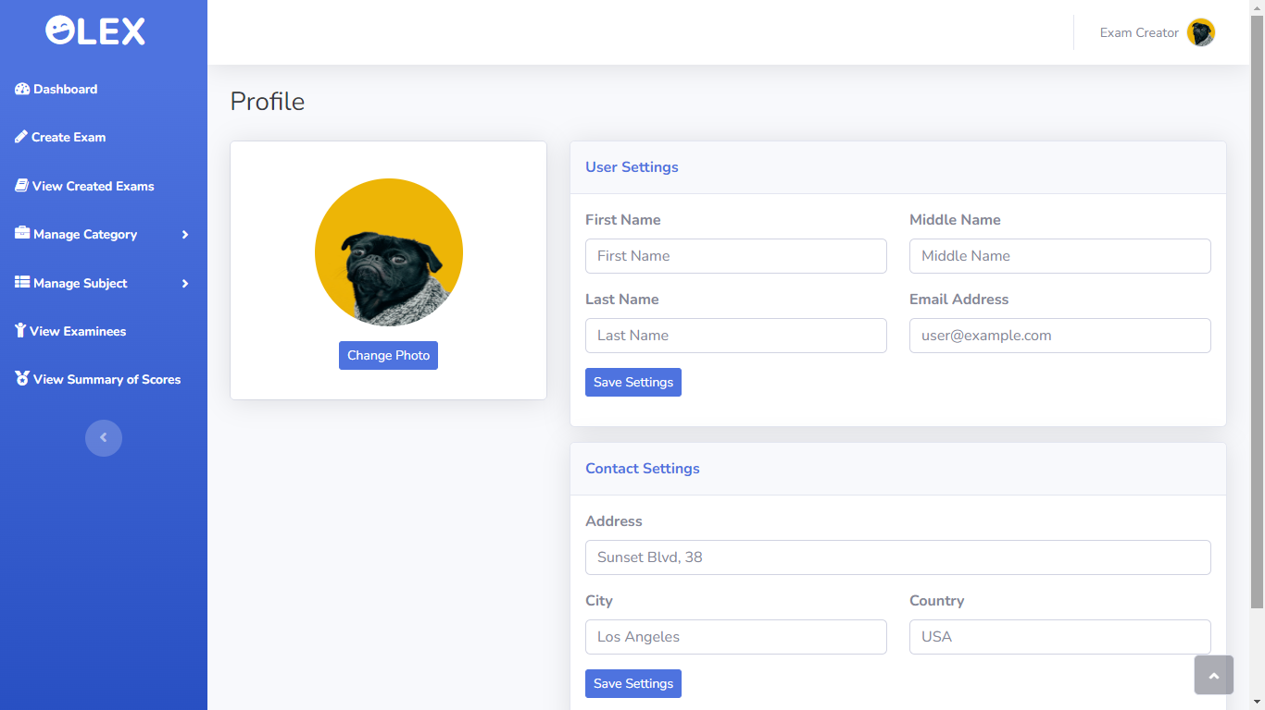

Slide 88
Examinee Dashboard

Slide 89
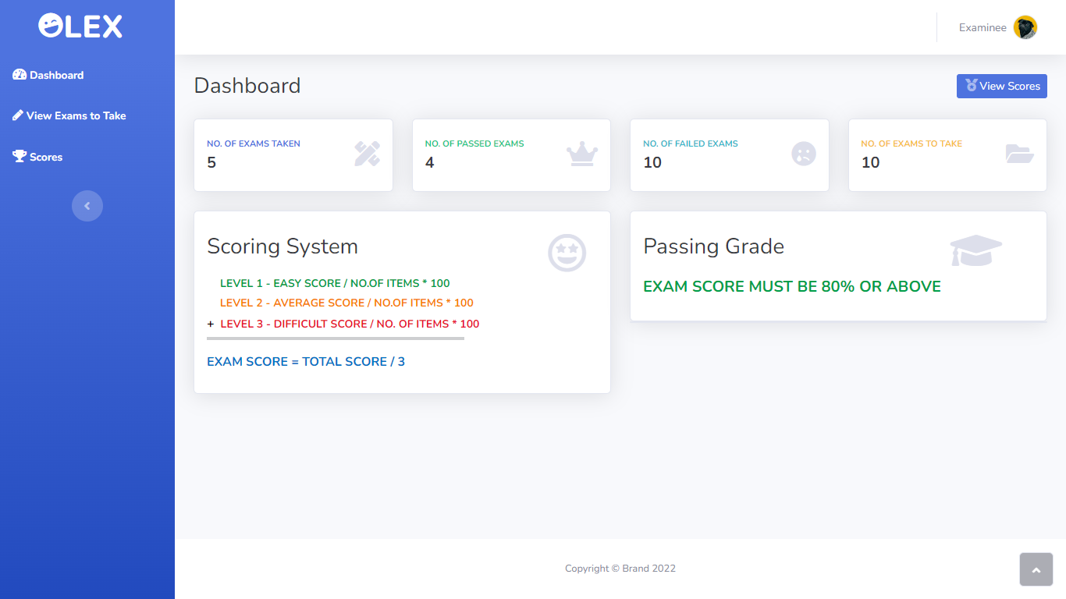

Slide 90
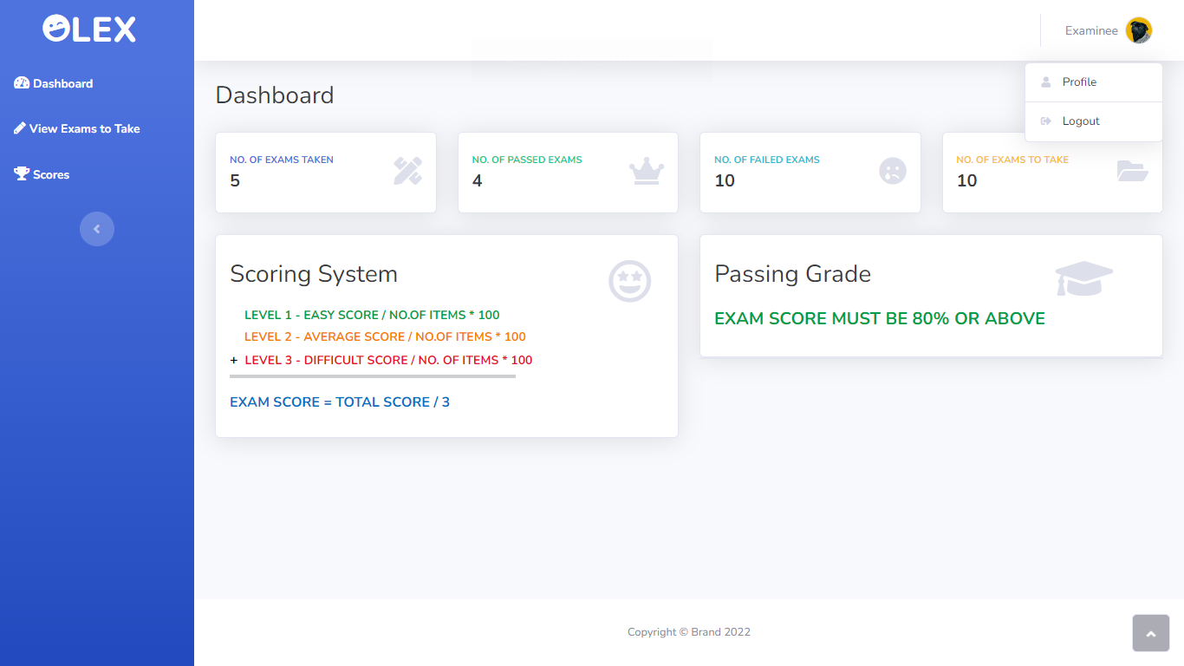

Slide 91
View Exam to Take Page

Slide 92
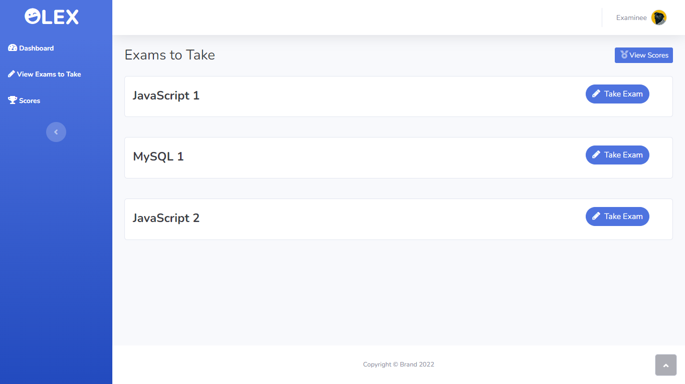

Slide 93
Take Exam Page Design

Slide 94
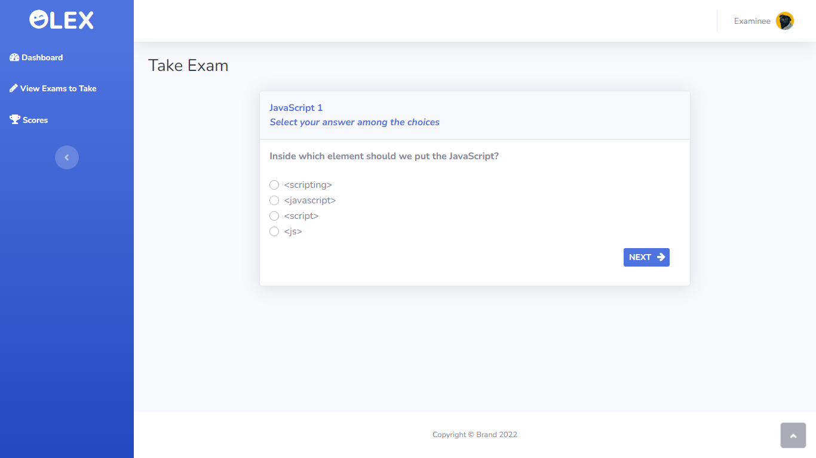

Slide 95
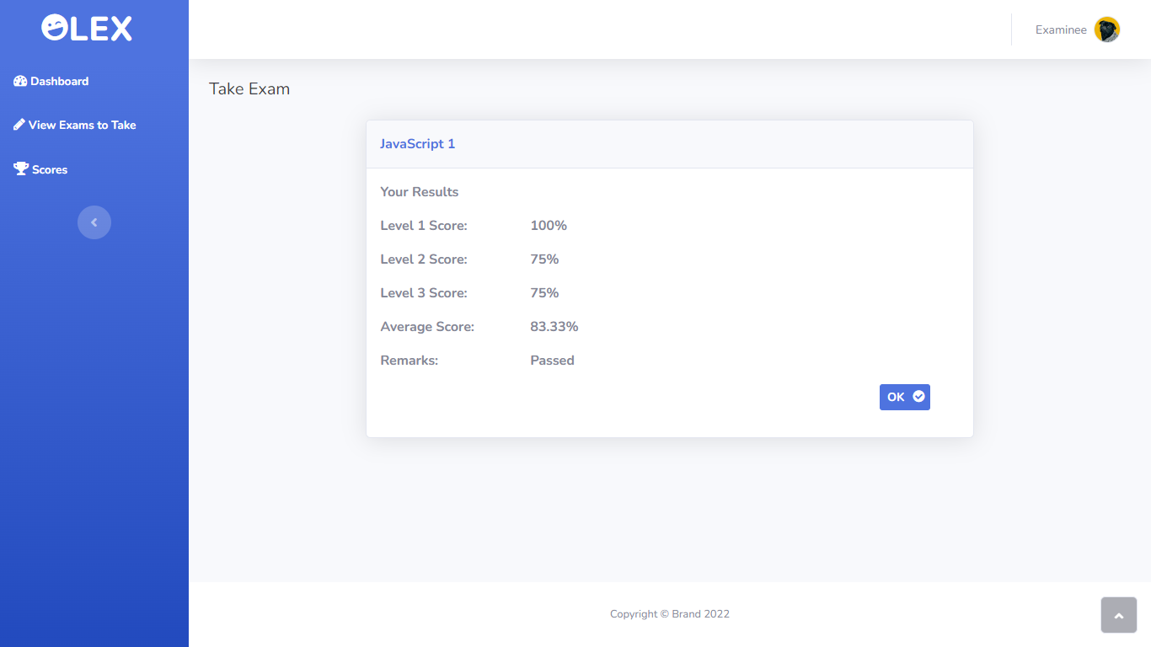

Slide 96
Examinee Update Profile Page Design

Slide 97
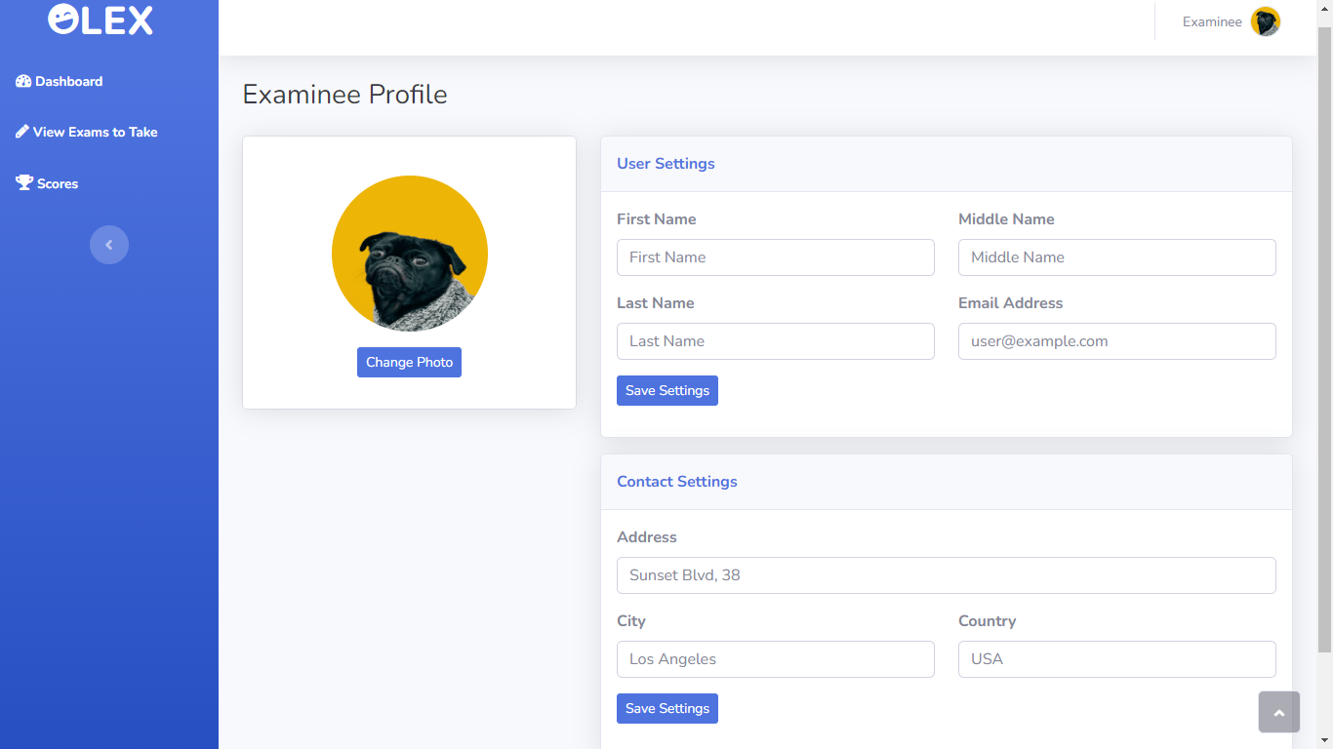

Slide 98
View Exam Scores

Slide 99


